Slide 1
Introduction to Computer Graphics with WebGL
Ed Angel
Professor Emeritus of Computer Science
Founding Director, Arts, Research, Technology and Science Laboratory
University of New Mexico

Slide 2
Agent Based Models
Ed Angel
Professor Emeritus of Computer Science
University of New Mexico

Slide 3
Objectives
Introduce a powerful form of simulation
Use render-to-texture for dynamic simulations using agent-based models
Example of diffusion
Angel and Shreiner: Interactive Computer Graphics 7E © Addison-Wesley 2015

Slide 4
Agent Based Models (ABMs)
Consider a particle system in which particle can be programmed with individual behaviors and properties
  different colors
  different geometry
  different rules
Agents can interact with each other and with the environment
Angel and Shreiner: Interactive Computer Graphics 7E © Addison-Wesley 2015

Slide 5
Simulating Ant Behavior
Consider ants searching for food
At the beginning, an ant moves randomly around the terrain searching for food
  The ant can leave a chemical marker called a pheromone to indicate the spot was visited
  Once food is found, other ants can trace the path by following the pheromone trail
Model each ant as a point moving over a surface
Render each point with arbitrary geometry
Angel and Shreiner: Interactive Computer Graphics 7E © Addison-Wesley 2015

Slide 6
Diffusion Example I
Two types of agents
  no interaction with environment
  differ only in color
All move randomly
Leave position information
  need render-to-texture
Diffuse position information
  need buffer pingponging
Angel and Shreiner: Interactive Computer Graphics 7E © Addison-Wesley 2015

Slide 7
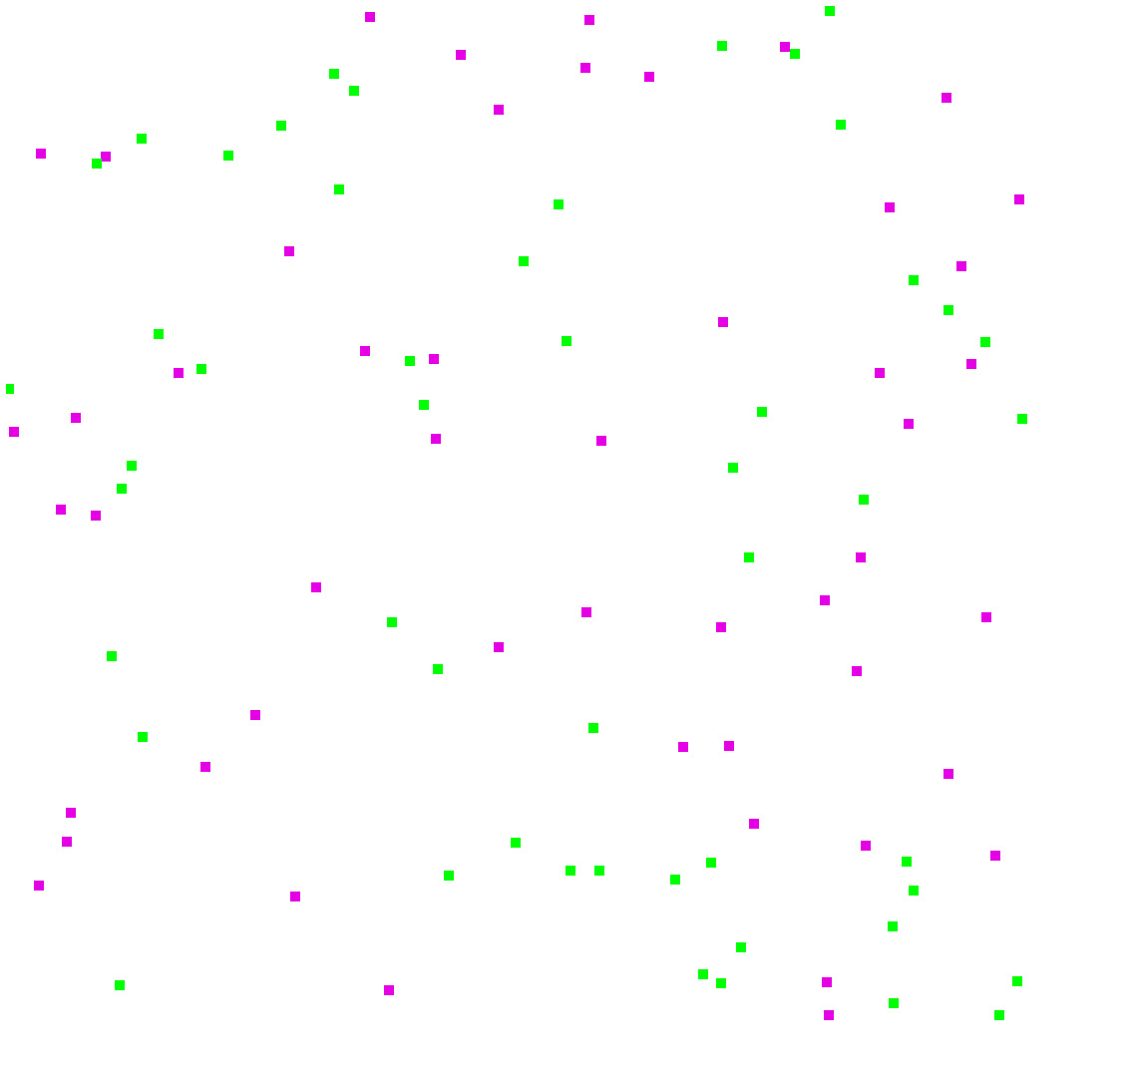
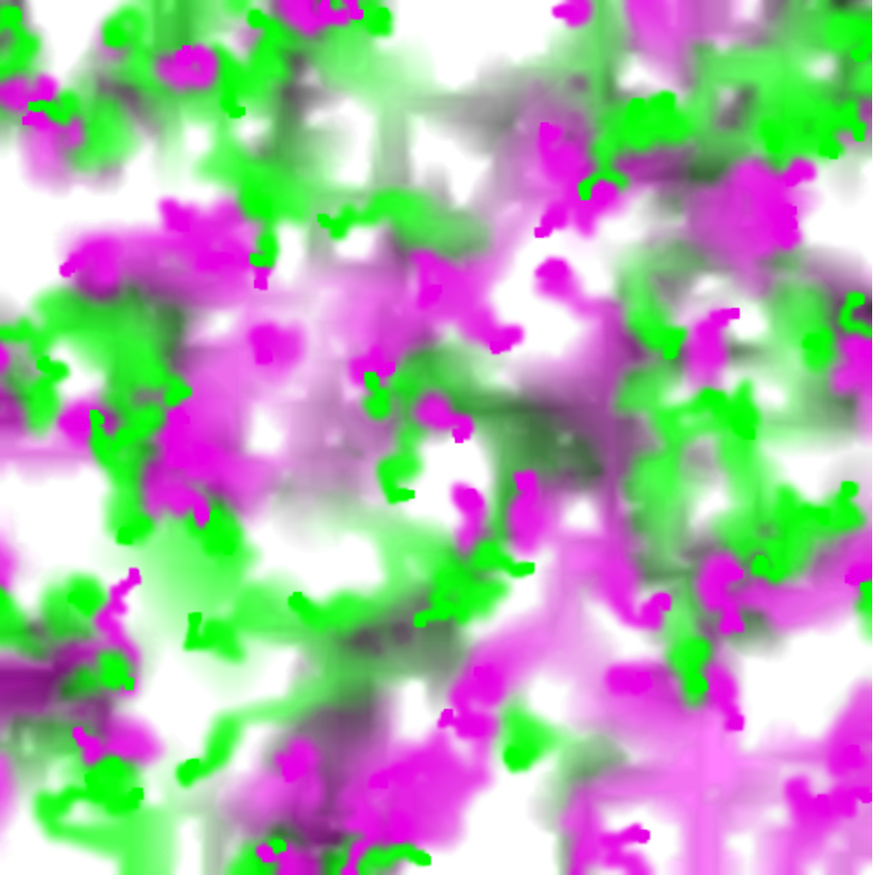
Snapshots
Angel and Shreiner: Interactive Computer Graphics 7E © Addison-Wesley 2015

Slide 8
Initialization
We need two program objects
  One for rendering points in new positions
  One for diffusing texture map
Initialization is standard otherwise
  setup texture objects
  setup framebuffer object
  distribute particles in random locations
Angel and Shreiner: Interactive Computer Graphics 7E © Addison-Wesley 2015

Slide 9

Vertex Shader 1
attribute vec4 vPosition1;
attribute vec2 vTexCoord;
varying vec2 fTexCoord;
void main()
{
gl_Position = vPosition1;
fTexCoord = vTexCoord;
}
Angel and Shreiner: Interactive Computer Graphics 7E © Addison-Wesley 2015

Slide 10
Fragment Shader 1
precision mediump float;
uniform sampler2D texture;
uniform float d;
uniform float s;
varying vec2 fTexCoord;
void main()
{
float x = fTexCoord.x;
float y = fTexCoord.y;
gl_FragColor = (texture2D( texture, vec2(x+d, y))
+texture2D( texture, vec2(x, y+d))
+texture2D( texture, vec2(x-d, y))
+texture2D( texture, vec2(x, y-d)))/s;
}
Angel and Shreiner: Interactive Computer Graphics 7E © Addison-Wesley 2015

Slide 11
Vertex Shader 2
attribute vec4 vPosition2;
uniform float pointSize;
void main()
{
gl_PointSize = pointSize;
gl_Position = vPosition2;
}
Angel and Shreiner: Interactive Computer Graphics 7E © Addison-Wesley 2015

Slide 12
Fragment Shader 2
precision mediump float;
uniform vec4 color;
void main()
{
gl_FragColor = color;
}
Angel and Shreiner: Interactive Computer Graphics 7E © Addison-Wesley 2015

Slide 13
Rendering Loop I
var render = function(){
// render to texture
// first a rectangle that is texture mapped
gl.useProgram(program1);
gl.bindFramebuffer( gl.FRAMEBUFFER, framebuffer);
if(flag) {
gl.bindTexture(gl.TEXTURE_2D, texture1);
gl.framebufferTexture2D(gl.FRAMEBUFFER,
gl.COLOR_ATTACHMENT0, gl.TEXTURE_2D, texture2, 0);
}
else {
gl.bindTexture(gl.TEXTURE_2D, texture2);
gl.framebufferTexture2D(gl.FRAMEBUFFER,
gl.COLOR_ATTACHMENT0, gl.TEXTURE_2D, texture1, 0);
}
gl.drawArrays( gl.TRIANGLE_STRIP, 0, 4 );
Angel and Shreiner: Interactive Computer Graphics 7E © Addison-Wesley 2015

Slide 14
Rendering Loop II
// render points
gl.useProgram(program2);
gl.vertexAttribPointer( vPosition2, 2, gl.FLOAT, false, 0, 0);
gl.uniform4f( gl.getUniformLocation(program2, "color"), 0.9, 0.0, 0.9, 1.0);
gl.drawArrays(gl.POINTS, 4, numPoints/2);
gl.uniform4f( gl.getUniformLocation(program2, "color"), 0.0, 9.0, 0.0, 1.0);
gl.drawArrays(gl.POINTS, 4+numPoints/2, numPoints/2);
// render to display
gl.useProgram(program1);
gl.vertexAttribPointer( texLoc, 2, gl.FLOAT, false, 0, 32+8*numPoints);
gl.generateMipmap(gl.TEXTURE_2D);
gl.bindFramebuffer(gl.FRAMEBUFFER, null);
// pick texture
if(flag) gl.bindTexture(gl.TEXTURE_2D, texture2);
else gl.bindTexture(gl.TEXTURE_2D, texture1);
Angel and Shreiner: Interactive Computer Graphics 7E © Addison-Wesley 2015

Slide 15
Rendering Loop III
var r = 1024/texSize;
gl.viewport(0, 0, r*texSize, r*texSize);
gl.clear( gl.COLOR_BUFFER_BIT );
gl.drawArrays( gl.TRIANGLE_STRIP, 0, 4 );
gl.viewport(0, 0, texSize, texSize);
gl.useProgram(program2);
// move particles in a random direction with wrap around
for(var i=0; i<numPoints; i++) {
vertices[4+i][0] += 0.01*(2.0*Math.random()-1.0);
vertices[4+i][1] += 0.01*(2.0*Math.random()-1.0);
if(vertices[4+i][0]>1.0) vertices[4+i][0]-= 2.0;
if(vertices[4+i][0]<-1.0) vertices[4+i][0]+= 2.0;
if(vertices[4+i][1]>1.0) vertices[4+i][1]-= 2.0;
if(vertices[4+i][1]<-1.0) vertices[4+i][1]+= 2.0;
}
gl.bufferSubData(gl.ARRAY_BUFFER, 0, flatten(vertices));
Angel and Shreiner: Interactive Computer Graphics 7E © Addison-Wesley 2015

Slide 16
Rendering Loop IV
// swap textures
flag = !flag;
requestAnimFrame(render);
}
Angel and Shreiner: Interactive Computer Graphics 7E © Addison-Wesley 2015

Slide 17
Add Agent Behavior
Move randomly
Check color where particle is located
If green particle sees a green component over 128 move to (0.5, 0.5)
If magenta particle sees a red component over 128 move to (-0.5, -0.5)
Angel and Shreiner: Interactive Computer Graphics 7E © Addison-Wesley 2015

Slide 18
Diffusion Code
var color = new Uint8(4);
for(var i=0; i<numPoints/2; i++) {
var x = Math.floor(511*(vertices[4+i][0]));
var y = Math.floor(511*(vertices[4+i][1]));
gl.readPixels(x, y, 1, 1, gl.RGBA, gl.UNSIGNED_BYTE, color);
if(color[0]>128) {
vertices[4+i][0] = 0.5;
vertices[4+i][1] = 0.5;
}
for(var i=numPoints/2; i<numPoints; i++) {
var x = Math.floor(511*(vertices[4+i][0]));
var y = Math.floor(511*(vertices[4+i][1]));
gl.readPixels(x, y, 1, 1, gl.RGBA, gl.UNSIGNED_BYTE, color);
if(color[1]>128) {
vertices[4+i][0] = -0.5;
vertices[4+i][1] = -0.5;
}
Angel and Shreiner: Interactive Computer Graphics 7E © Addison-Wesley 2015

Slide 19
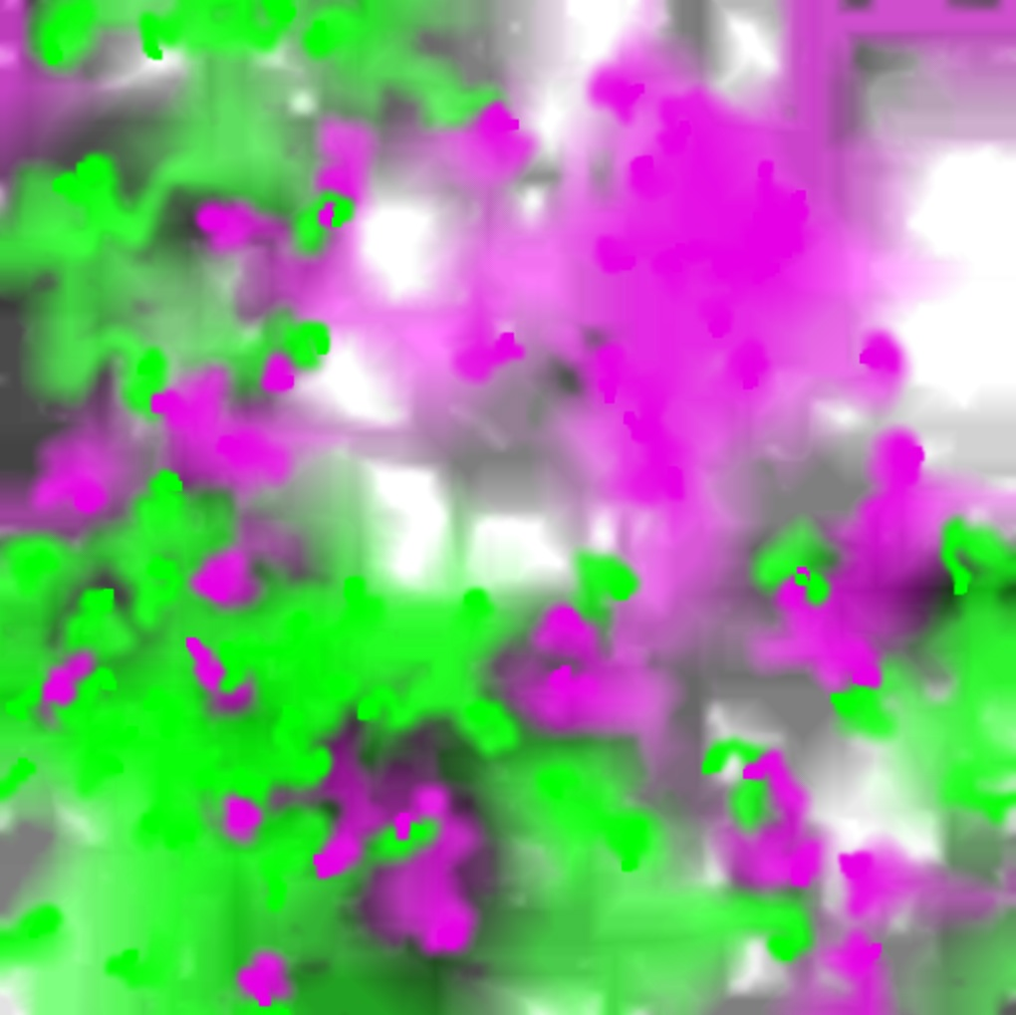
Snapshots
without reading color
with reading color
Angel and Shreiner: Interactive Computer Graphics 7E © Addison-Wesley 2015

